Slide 1
Automatic Attendance System

Slide 2
Contents
Introduction
Previous work
System design
Proposed system
Future work
Conclusion

Slide 3
1. Introduction
What is our project ?
Why QR code ?
History of QR code
What is QR code ?

Slide 4
Automatic Attendance System
Our project is QR code attendance system that takes the attendance report by scanning the QR code in the class room
Security: prevent the students from attending each other
Efficiency: Higher performance and faster attendance
Safety: less physical communicating (due to our covid-19 pandemic)

Slide 5
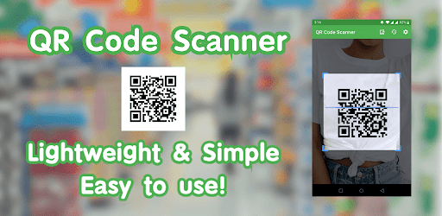
Why QR Code ?

Slide 6

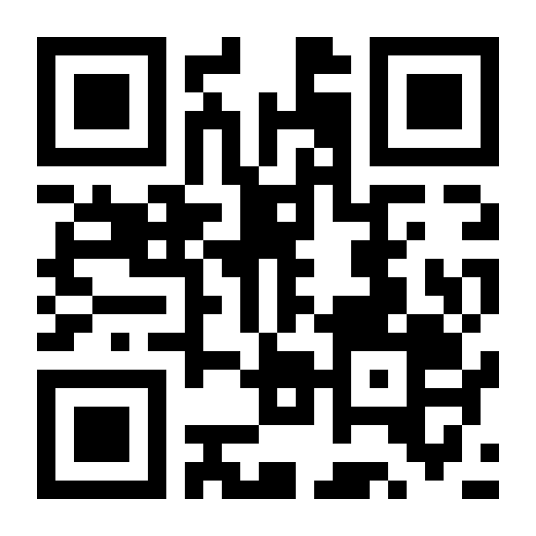

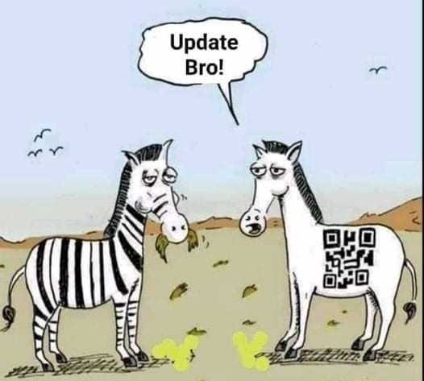
History Of QR Code
Barcode
QR code
Colored QR code

Slide 7
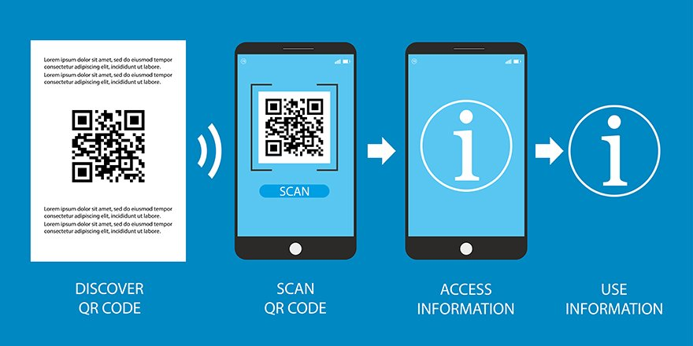
What Is QR Code ?

Slide 8
2.
Previous Work
How it started ?
What they failed to do ?
Project key features ?

Slide 9

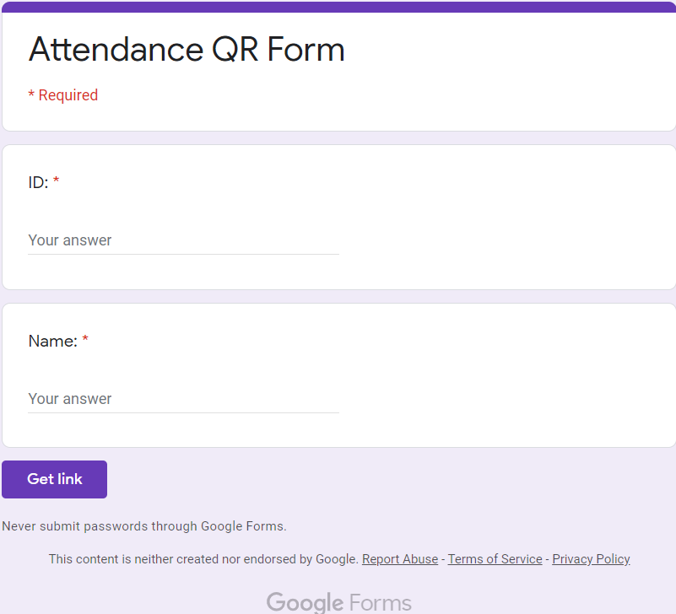
How It Started ?
Google was the first company to start this project
It was in a form of questions

Slide 10
What They Failed To Do ?
No tracking application for students attendance activity
Low security
Slower process
Duplicate attendance
QR code for every student

Slide 11
Project Key Features
Full tracking application
Logging in and scan time
Total semester attendance
Specific information for every single student
Higher Security
IP address & mac address security
Location detection of the student

Slide 12
Project Key Features
High Performance
Easy to use
Fast in taking attendance
Less complex data
High Accuracy
Get the right date
Can’t duplicate attendance

Slide 13
3. System Design
Software design models
Instructor flow chart
Student flow chart
Overall System design

Slide 14
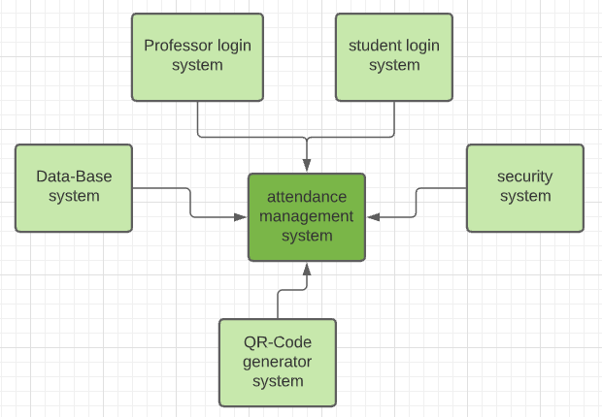
Software Design Models
context model

Slide 15
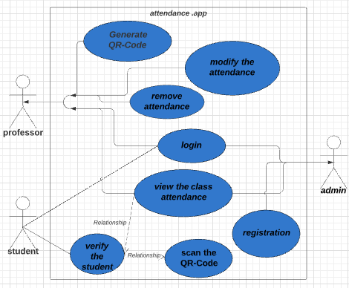
Software Design Models
Use case diagram

Slide 16
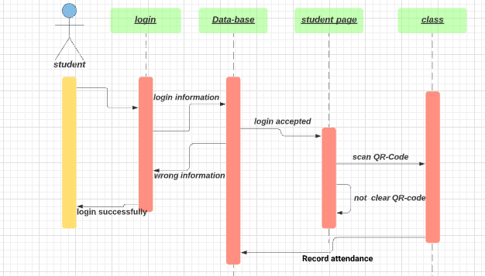
Software Design Models
Sequence diagram model

Slide 17

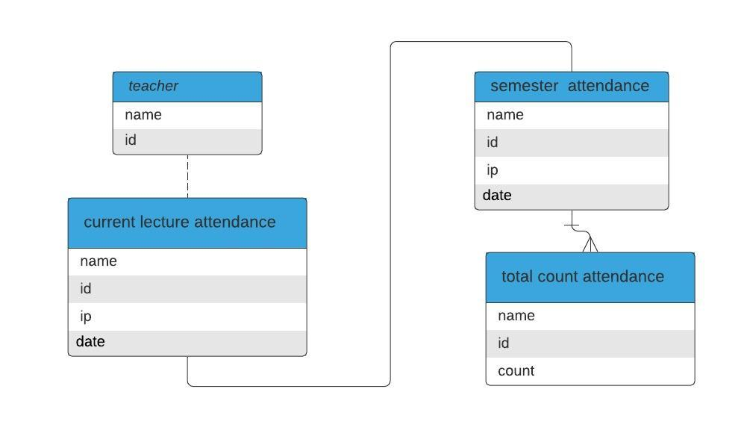
Database Of The Website
Table diagram of the website database

Slide 18
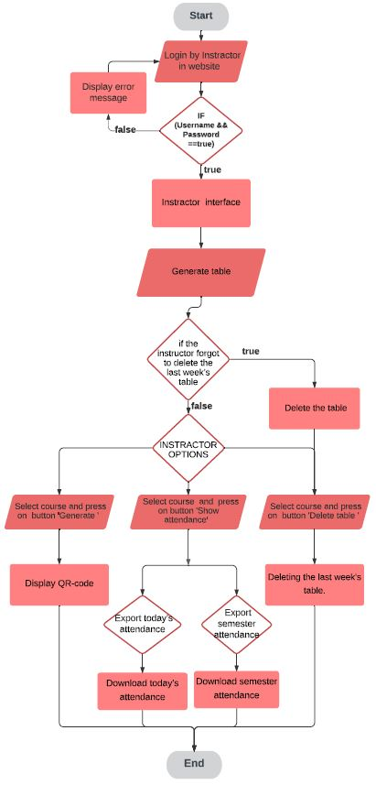
Instructor Flow Chart

Slide 19
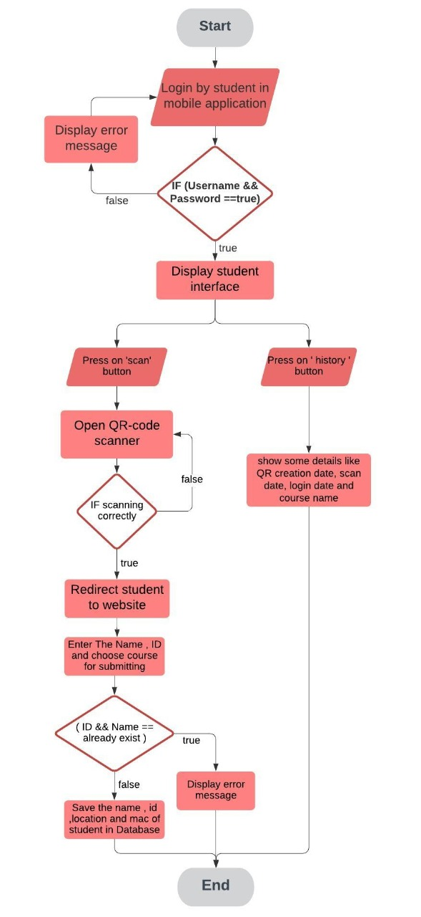
Student Flow Chart

Slide 20
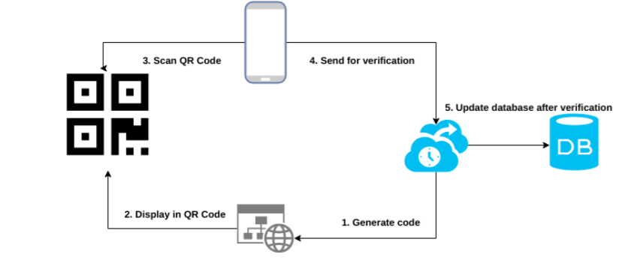
Overall System design

Slide 21
4. Proposed System
Website
Database
Mobile application

Slide 22

Website
Languages & tools used in the website
Html 5 for the webpage
CSS for styling the webpage
JavaScript for QR generating and dynamic web page
Php & MySQL for database link
Microsoft Vscode for coding

Slide 23
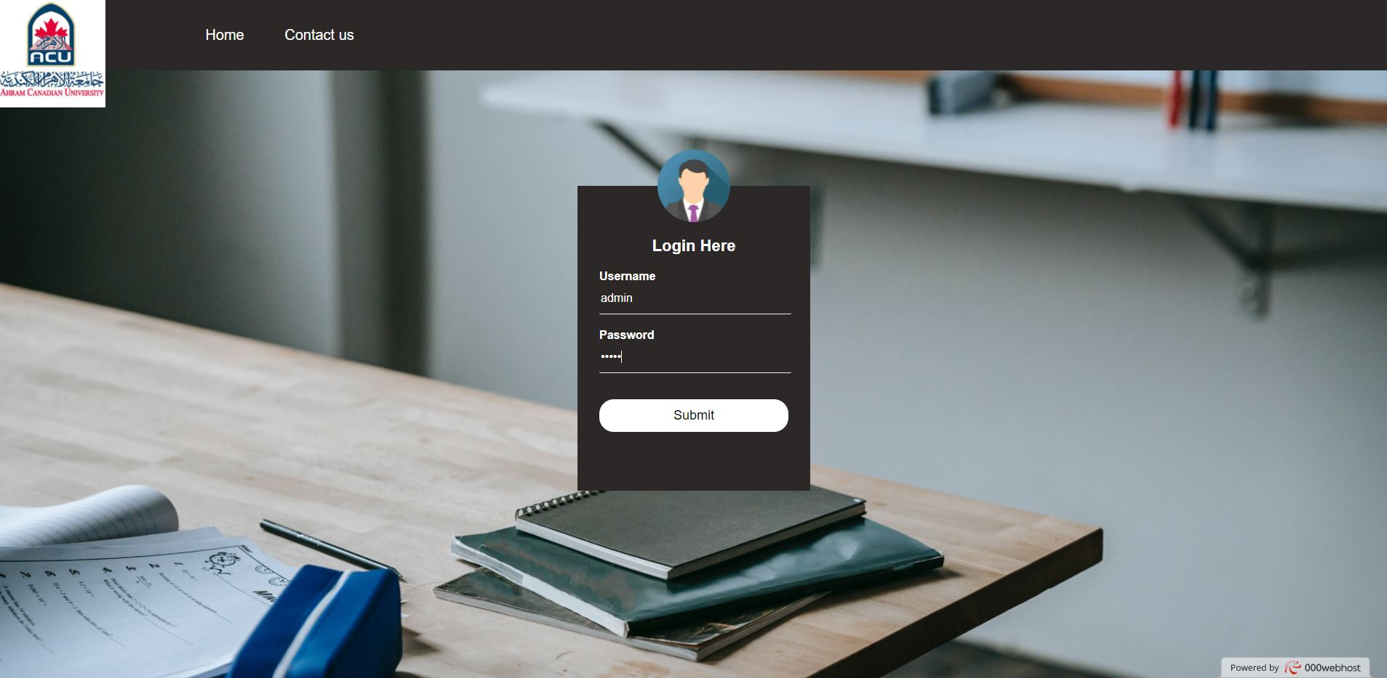
Website
Instructor UI

Slide 24
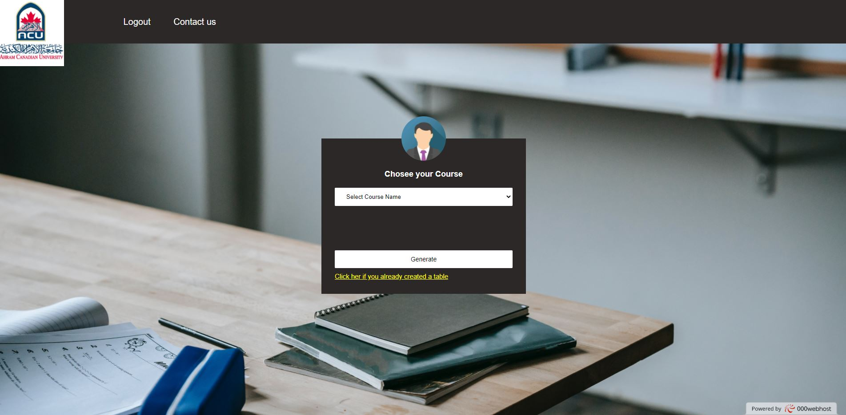
Website

Slide 25
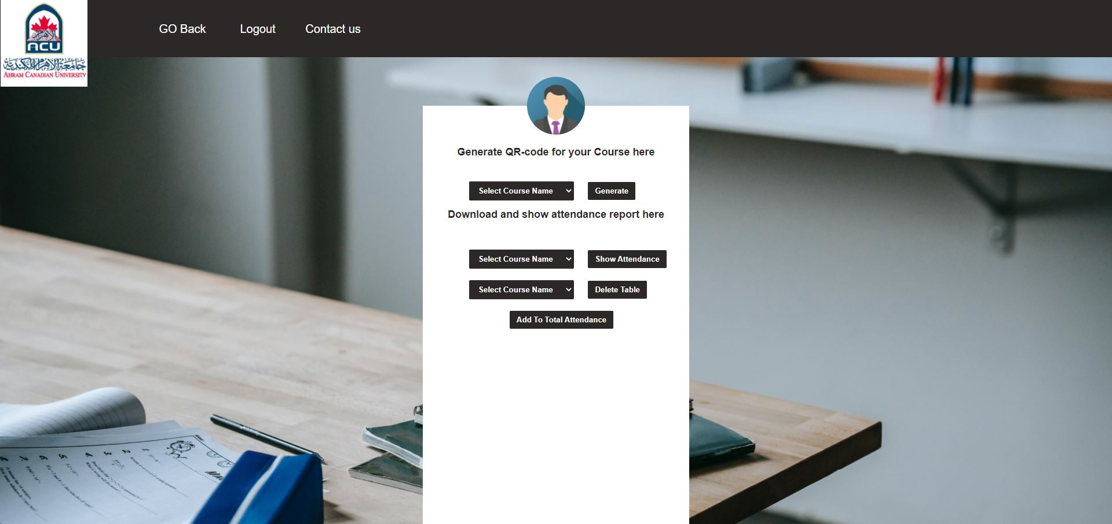
Website

Slide 26
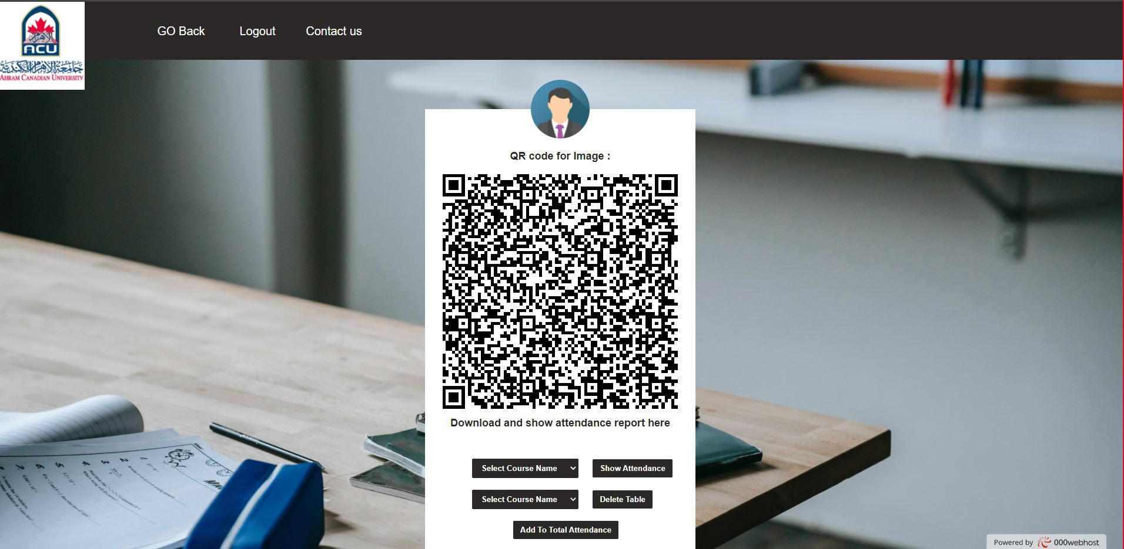
Website

Slide 27
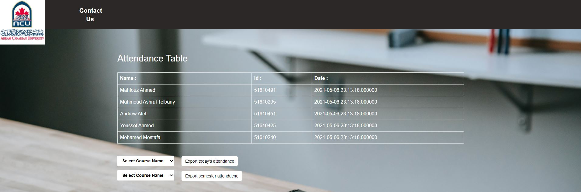
Website

Slide 28

Database
Database of the website
Data base of the mobile application

Slide 29
Database Of The Website
Tools and languages used in database
PHP & SQL
PhpMyAdmin
Advantages
Dynamic and Ease of use
Contains an uncomplicated graphical UI
Allows the users to copy and paste queries from other systems
Allows admin to fetch results from application

Slide 30

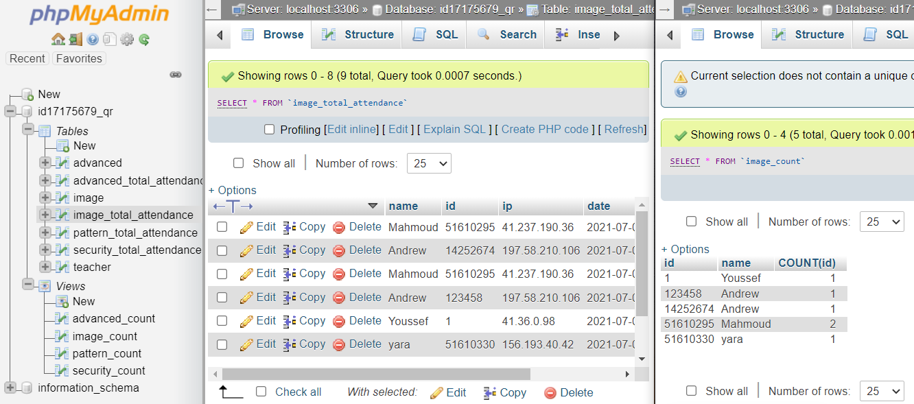
Database Of The website

Slide 31

Mobile Application
Languages & tools used in project
Flutter & dart for application UI
Firebase & firestore for application database
Android studio for coding

Slide 32


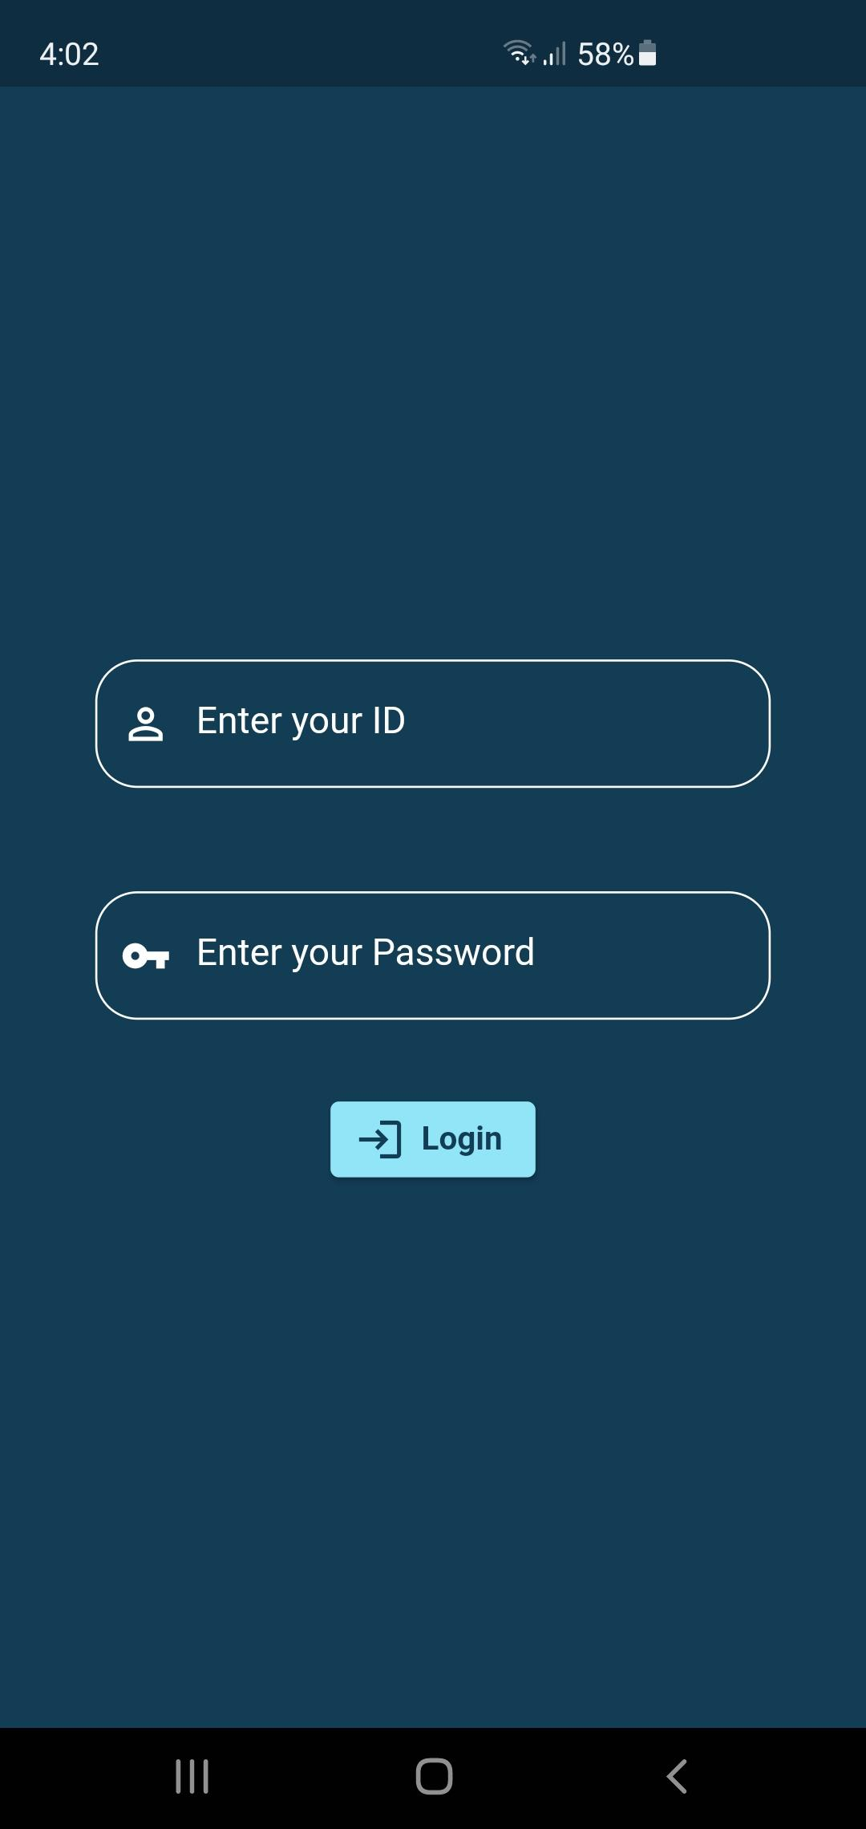
Mobile Application

Slide 33
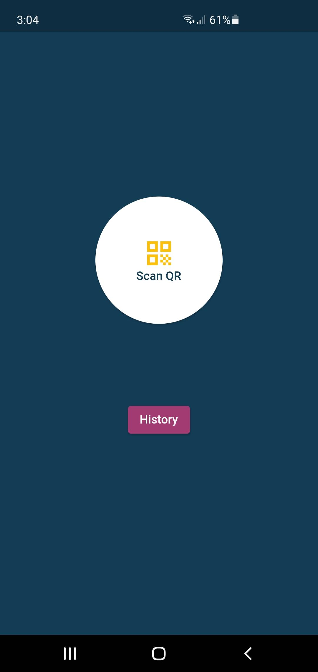
Mobile Application
Scanning page

Slide 34
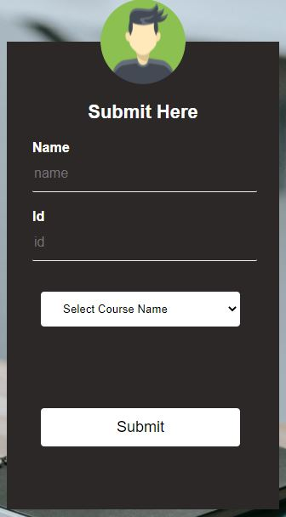
Mobile Application
Redirecting to website page

Slide 35
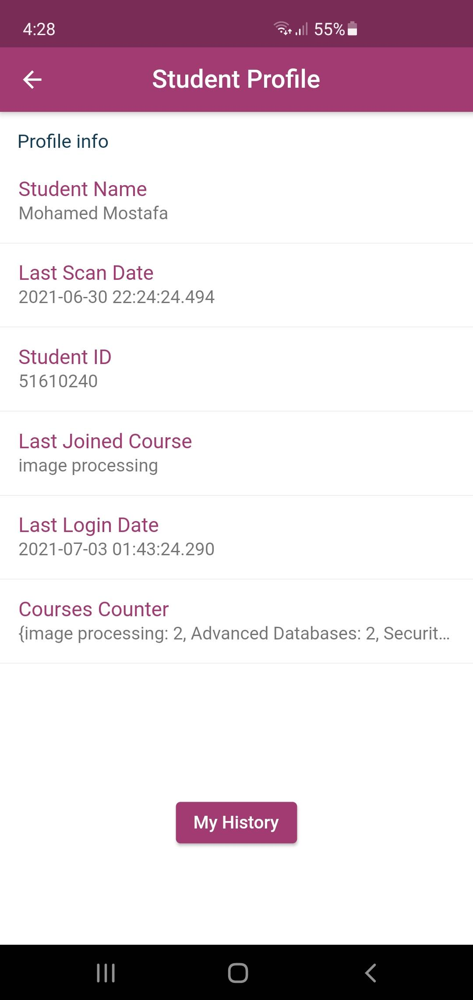
Mobile Application
Students information

Slide 36
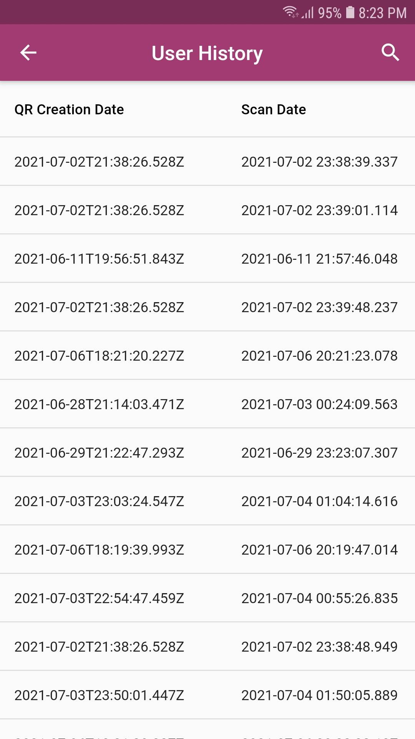
Mobile Application
Students information

Slide 37
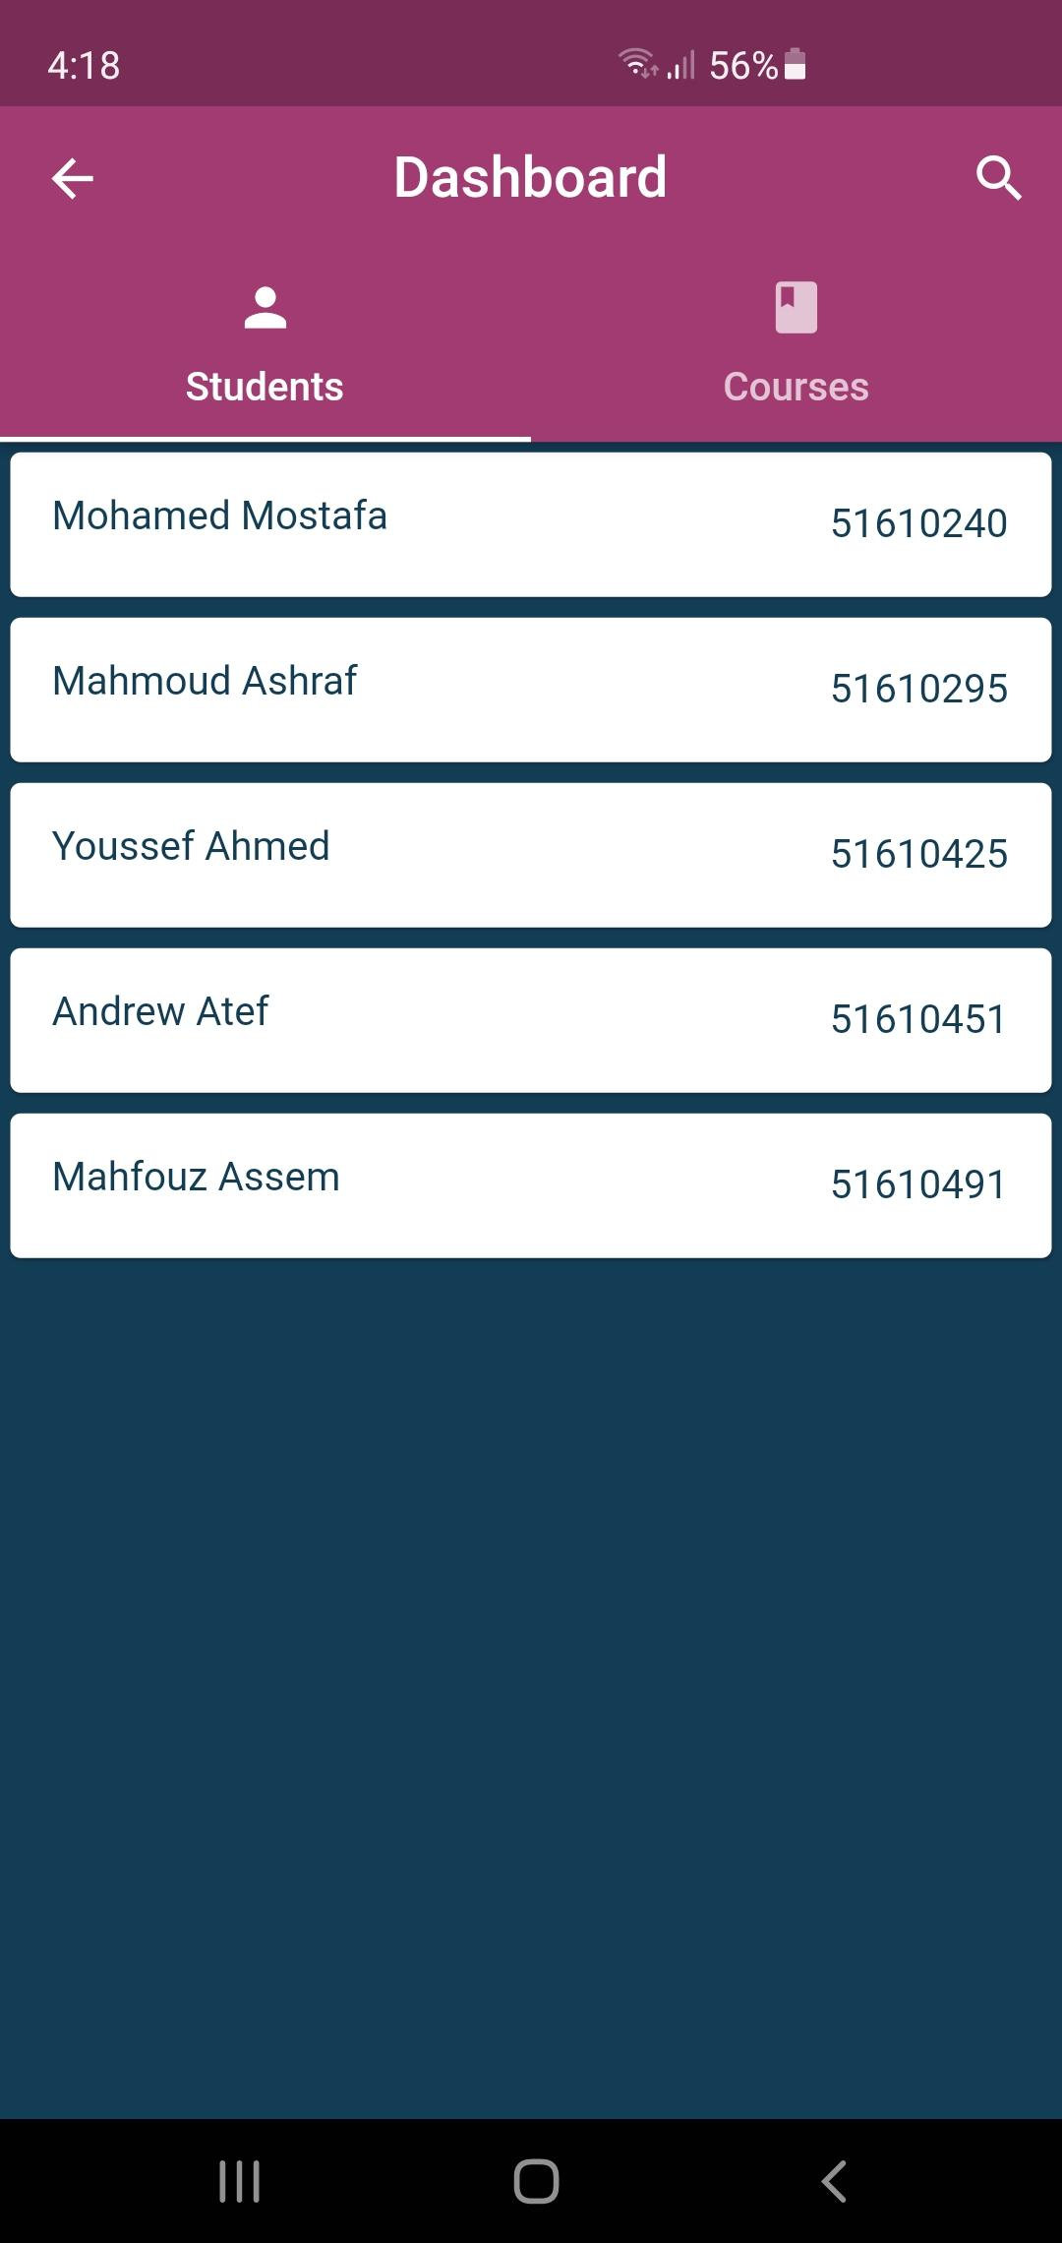
Mobile Application
The instructor UI of
the mobile application

Slide 38
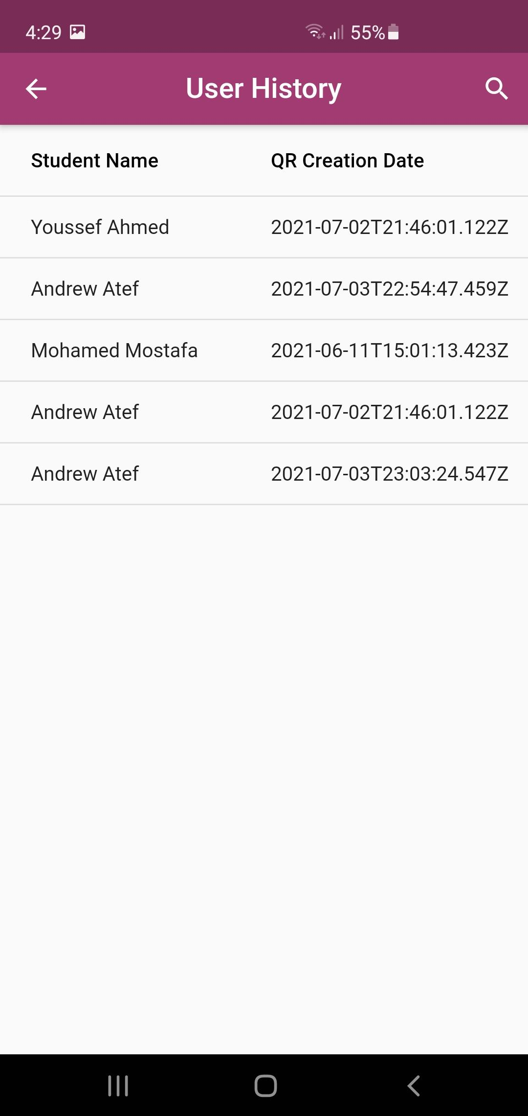
Mobile Application
Students Scanning dates

Slide 39
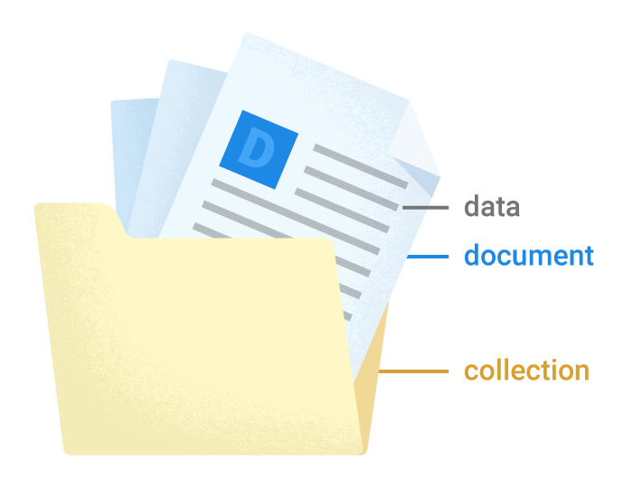
Database of Mobile Application
Tools and Techniques are using
Firebase
Cloud Firestore
NoSQL
Advantages
Sync across all user devices and Ease of use
Offline support
Flexibility
Realtime updates
Designed to scale

Slide 40
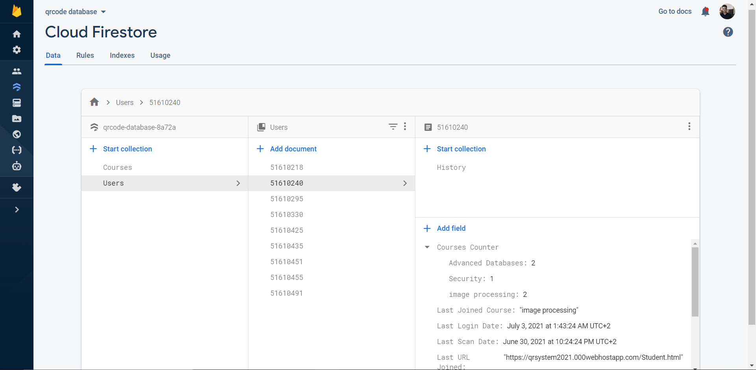
Database of the mobile application

Slide 41
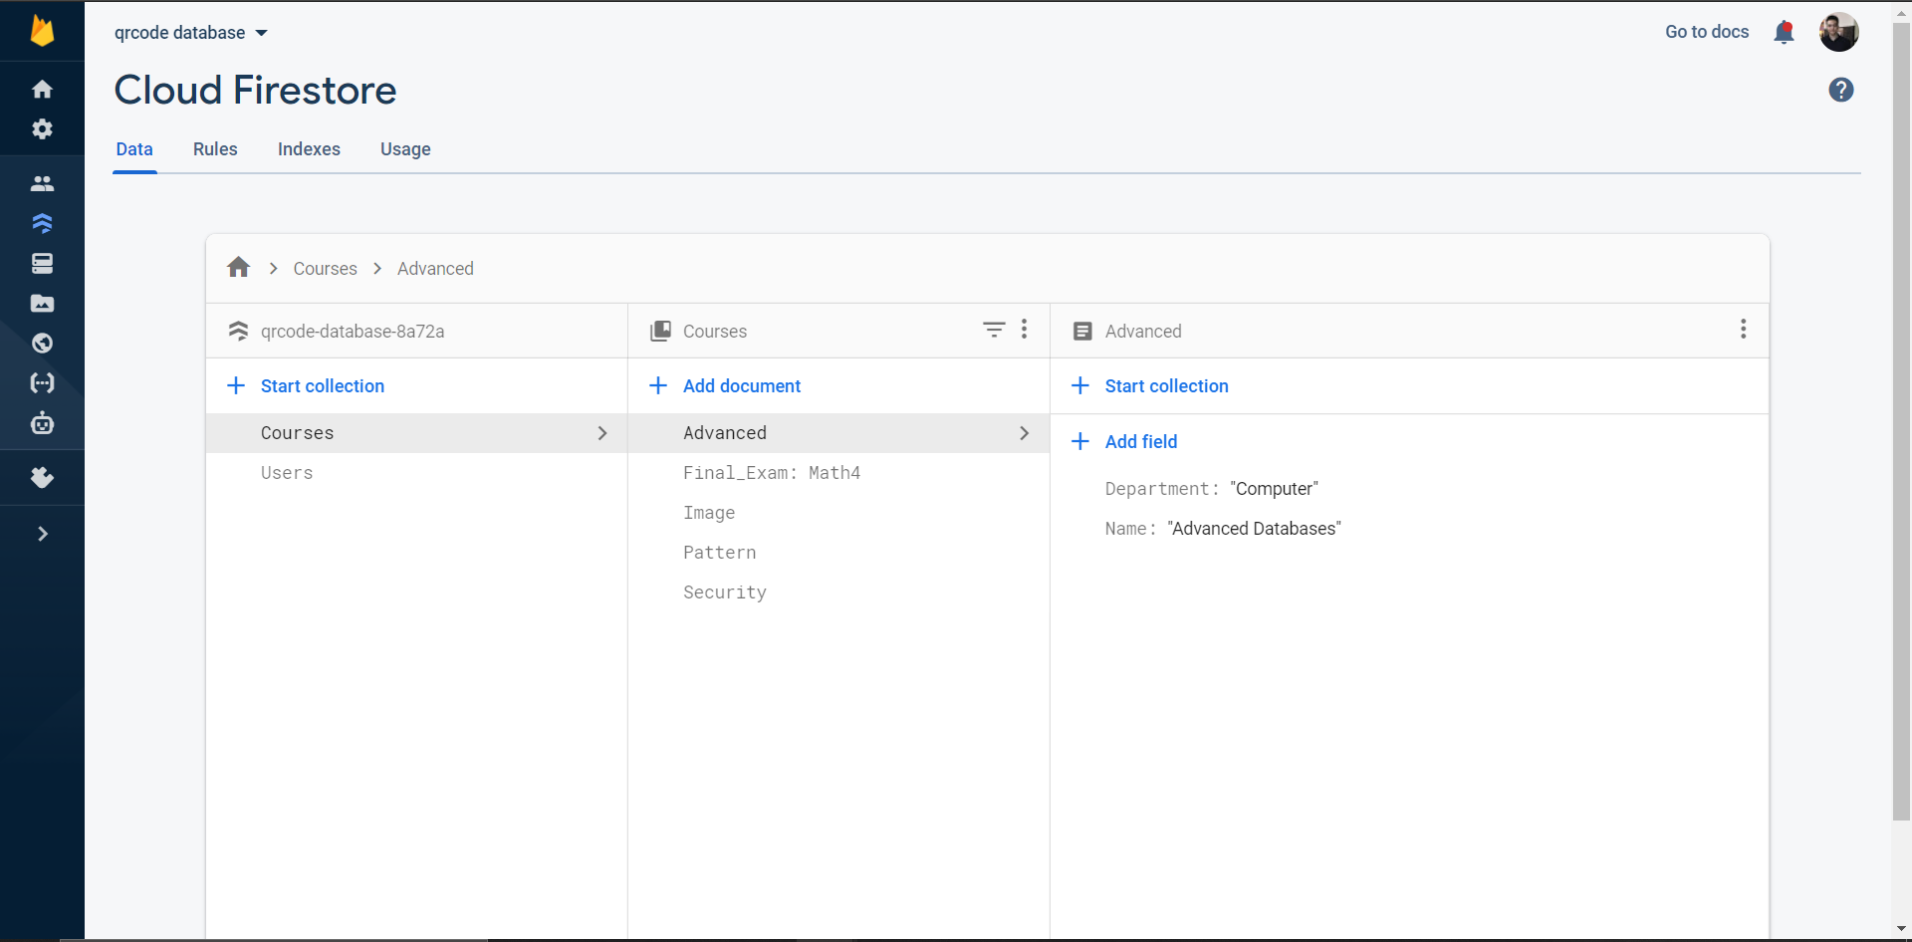
Database of the mobile application

Slide 42
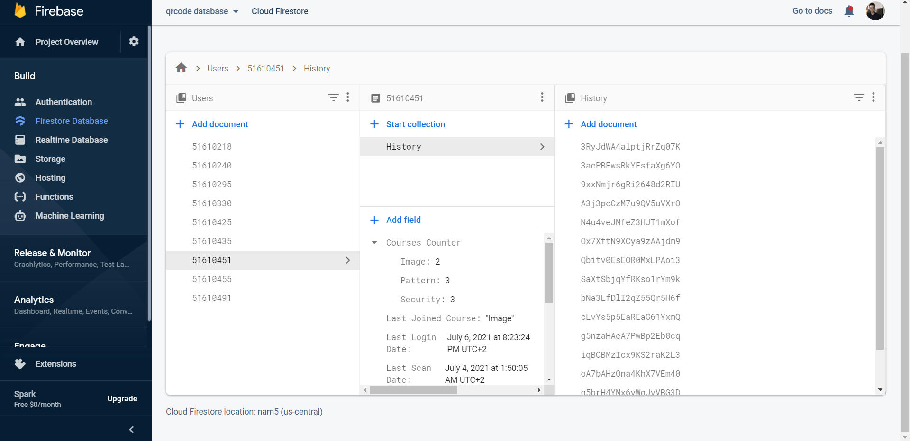
Database of the mobile application

Slide 43
Future Work
Accept scans only from a specific location of the class room
Identify student by facial recognition system in the mobile application not by username & id

Slide 44
Conclusion
QR code is a modern technology, easy, fast, and friendly to use.
QR code attendance system make taking attendance more secure and safe especially now in the covid-19 pandemic.

Slide 45
Thanks!
Any questions?

